Slide 1
Turtlebot following a straight line by observing a square
Group 6 Project 6:
Rosh Dela Cruz – 14264764
Matthew Egan - 14289692
Daniel Lo - 14289716

Slide 2
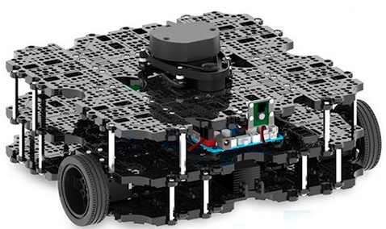
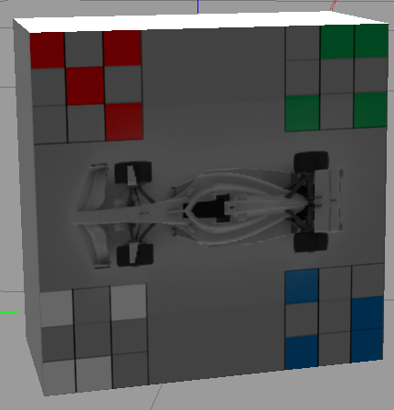
Project overview
To utilise ROS in Ubuntu 18.04.
To utilise a Turtlebot3 in the Gazebo environment.
GOAL: to manipulate a Turtlebot to follow a straight line by observing the a square and its 4 corners with an RGB-D camera.
Square image is placed within observable range, containing a grid layout for corners and an image of a car
To implement and use image processing algorithms.
To implement a PID controller to manipulate movement of Turtlebot to goal.

Slide 3
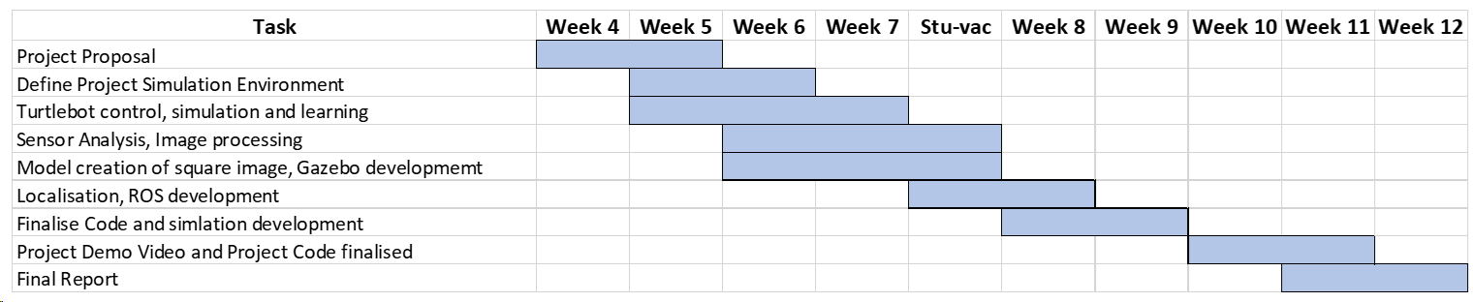
Project timeline

Slide 4
Methodology
To initialise the ROS environment
Subscribing to topics/nodes, to receive data for Turtlebot
Building Gazebo environment, designing square image and features
Image data extraction and processing
Turtlebot will rotate on position to determine location of square image
Utilise an initial image to feature of square image against
SURF edge detection to identify the image and features are accurate
Determine position relative to square
PID Controller
Calculates error between orientation of Turtlebot to target and creates adjustments to movement and control.
Turtlebot will first face parallel to target square and move in a straight line
Moves forward until square is perpendicular to Turtlebot
Once facing square, rotates 90 degrees until directly in front
Sends ROS messages e.g. linear and angular velocity to move Turtlebot to position of Square image

Slide 5
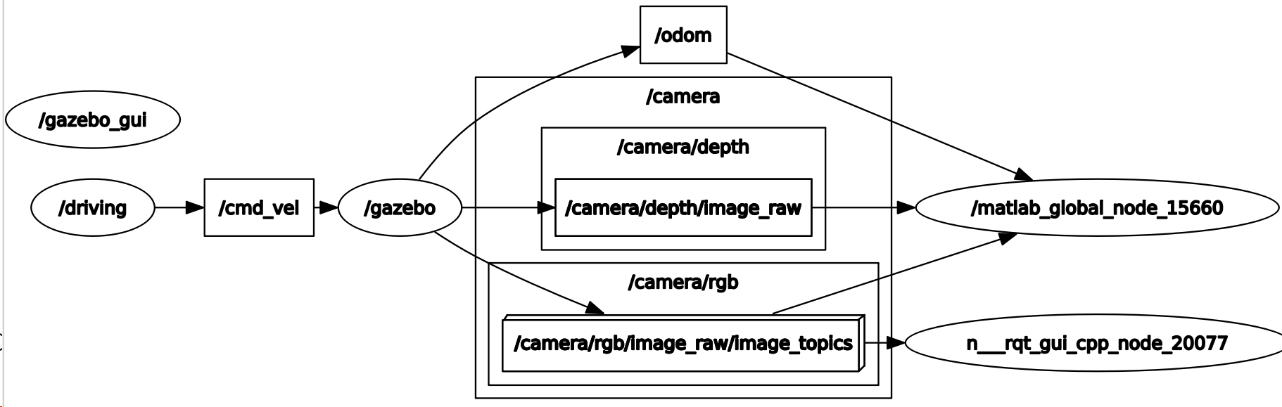
ROS graph

Slide 6
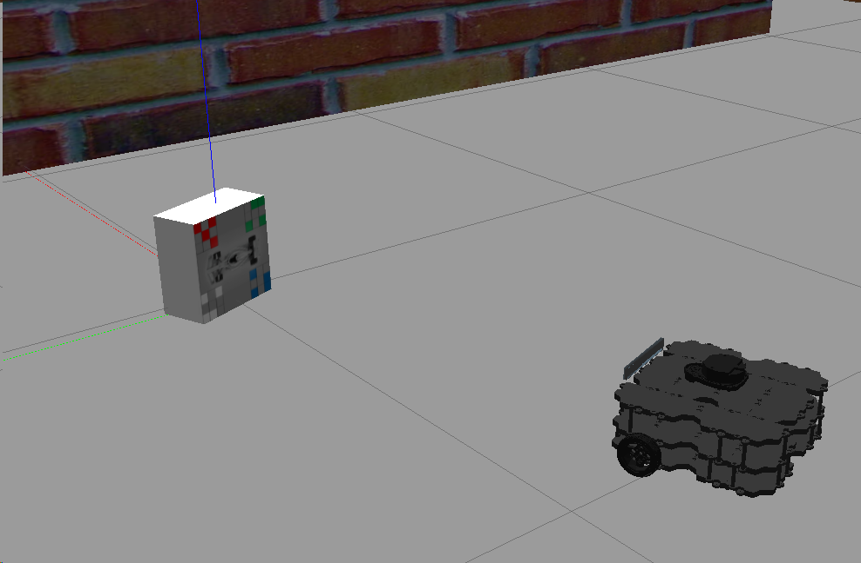
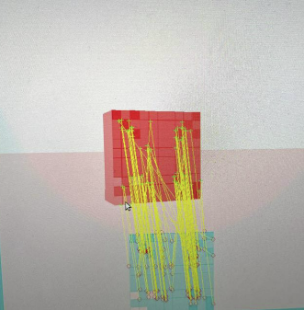
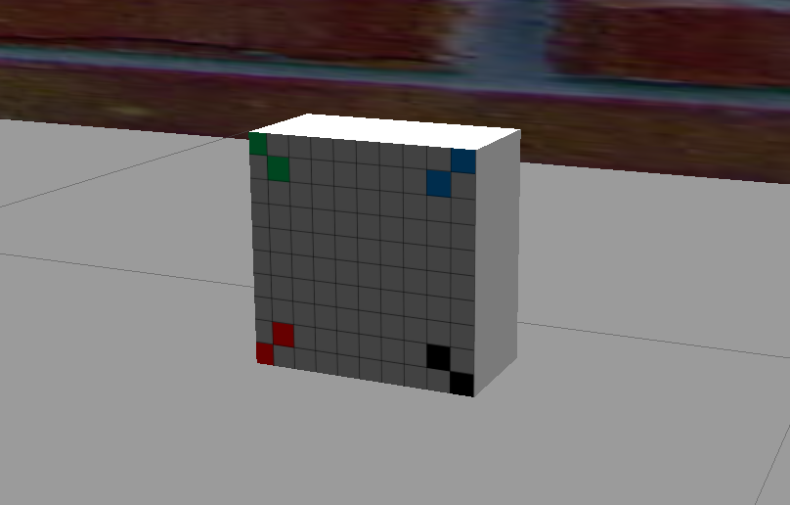
Experiments
SURF detection
KAZE detection
MATLAB profiler
Computational/memory usage
Total run time
Function usage
Gazebo simulation/world building
Implementation of walls, surfaces
Creation of Square image and development over time to test variety of patterns and features

Slide 7
Project issues/difficulties
Simulation running was inconsistent across team members and computers
Gazebo environment crashing, lack of computational power
Orientation calculation issues
Development of square image and image processing working consistently

Slide 8
Project video demo and results

Slide 9
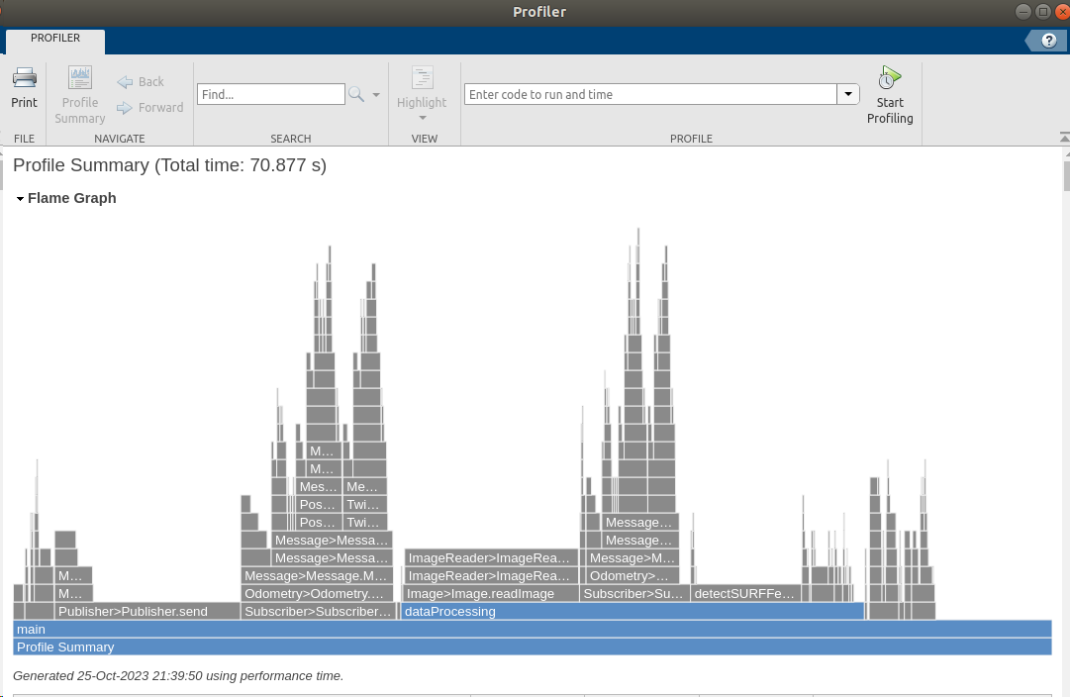
Final results

Slide 10
Thanks for watching

